Slide 1
DSC3013 Intro. to Social
Media Analytics (Lec. 6)
Hao PENG
Department of Data Science
City University of Hong Kong
https://haoopeng.github.io/

Slide 2
Agenda for this week
Audience analytics
User demographics
Psychological traits
Political affiliations
Health informatics
Notes:
In text analysis, we deal with individual post
In user modeling, we deal with each user’s collection of posts

Slide 3
Audience analytics
Sentiment and emotion are “text-level” characteristics
Lots of user-level social / psychological attributes
  Demographics (age, race, gender, income, etc)
  Psychological traits (personality, sexual orientation, prosociality)
  Political affiliation, user interests, communities, incivility, etc.
  Mental health/state (empathy, depression, stress, etc)
  Healthy lifestyle (weight lose, eating disorder, early riser)
  …

Slide 4
Audience analytics
Audience analytics aims to understand the demographic & psychographic characteristics of social media users such as audience size, location, gender, age, and interests, etc.
By leveraging audience analytics, businesses & org. can gain invaluable insights into who their followers are, where they come from, and what they care about, enabling the creation of more targeted and effective marketing strategies.

Slide 5
Examples of audience analytics
Product Development Insights—A gaming company discovers through audience analytics that a substantial number of its X followers are female gamers interested in role-playing games (RPGs). This insight leads to the development of a new RPG with strong female lead characters, directly catering to this audience segment.
Geographical Targeting—A coffee chain uses audience analytics to find out that a large number of its Facebook followers are located in northeastern of United States. This insight guides the chain's decision to run a special promotion in those regions, capitalizing on the high concentration of followers there.

Slide 6
Demographic analysis
Demographics refer to the statistical characteristics of human populations and particular groups within it. This includes:
Age: Knowing the age distribution of audience can help tailor content to be more relatable and engaging.
Gender: Understanding the gender breakdown can inform product offerings and effective marketing messages.
Race/Ethnicity: One of the most important social identities in racially diverse countries such as the U.S.
Location: Location data helps in understanding geographical representation and can help design marketing campaigns.

Slide 7
Gender
Biological/sex-based definition
  Refers to biological characteristics (female vs. male)
  Often used in medical treatments
Social/cultural definition
  Refers to social roles, behaviors, and expectations societies assign to individuals based on their perceived sex.
  They can vary across cultures and history.
Gender Identities
  Binary (women vs. men)
  Non-binary, mixed, trans

Slide 8
Gender inference
Name-based classifier
  Prediction (mostly on first name): https://genderize.io/
  Limitations?
  Error rates?
  Does error vary by race / ethnicity?
  Unknown vs. Unisex
Gender prediction based on linguistics
Self-identified gender vs. inferred label
  The two (often) can differ
  Use inferred gender when the perceived attribute is key
  Use self-identified label when the true attribute is key

Slide 9
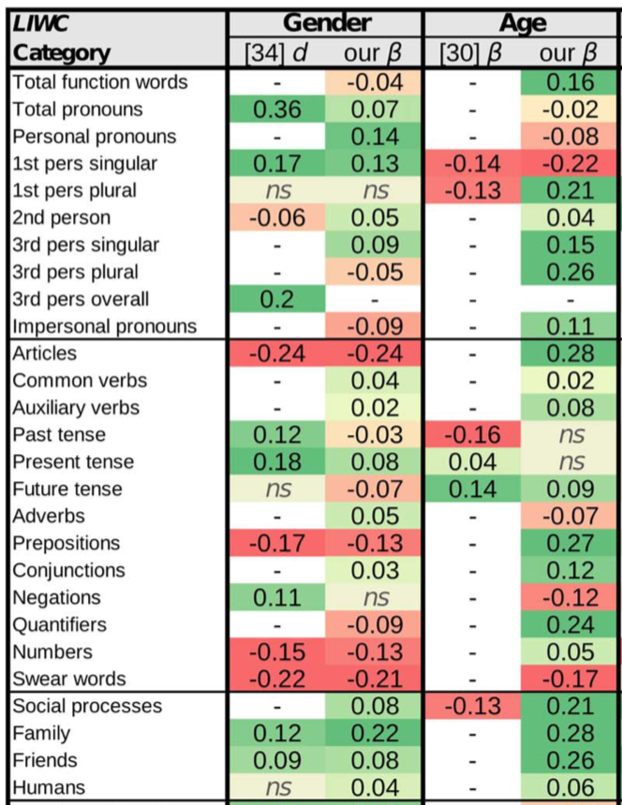
LIWC for predicting gender
https://doi.org/10.1371/journal.pone.0073791

Slide 10
Which one should be used?
Inferred (predicted) or true gender label?
Study gender representation in leadership positions
Examine gender bias in hiring / interview
Test gender gap in grade / salary negotiation
Quantify gender diversity on team performance
What if self-identified gender label is not available in data?

Slide 11
Race, nationality, ethnicity
Race:
  Based on appearance (Asian, Black, Hispanic, White, etc.)
  Could be broken down into finer categories (East vs. South Asian)
Nationality (or Country/Geography):
  Objective, but hard to know without self-identities
  Asian --> Chinese, Japanese, Korean, etc.
  White --> England, French, Germany, Italian, etc.
Ethnicity:
  Nationality is about country’s flag; ethnicity is about cultural roots
  Can differ from one’s nationality due to migration and immigration
True vs. predicted /perceived identity
  In many cases, they are not identical (e.g., Michael Jackson)
  Sometimes, perceived attribute is what actually matters
  Which one should you use? In what contexts?

Slide 12
Name-based classifier
Last name contains more useful information.
Race prediction:
  https://ethnicolr.readthedocs.io/ethnicolr.html
Nationality prediction:
  https://nationalize.io/
Ethnicity prediction
  http://abel.lis.illinois.edu/cgi-bin/ethnea/search.py

Slide 13
Exercise time (discuss in 5 min)
Which attributes should you use?
Study how author’s affiliation impacts news coverage
  Asians who live in U.S., white people who live in HK, etc.
Examine demographic bias in U.S. media representation
  Baseline: population within the same geo. region

Slide 14
Socioeconomic status (SES)
Education
Occupation
Income level
SES: a concept used by economists & sociologists. The measure combines a person‘s work experience and their or their family’s access to economic resources & social position relative to others.
Social class: refers to a person’s relatively stable cultural background, whereas SES refers to one’s current social & economic situation which is more changeable over time.
https://en.wikipedia.org/wiki/Socioeconomic_status

Slide 15
Case study on user demographics
How to understand the demographic composition of a brand's social media followers using techniques in SMA?
Tool Setup: Use APIs to access audience data from a brand’s Facebook or Instagram account.
Data Collection: Extract data on age, gender, and location.
Data Analysis: Create visualizations (pie charts for gender distribution, age histograms, and heat maps for location) to display the demographic data.
Reporting: Write a report on how the brand‘s content might be tailored to better suit the diverse demographics of its users.

Slide 16
Psychographic analysis
Psychographics delve into the psychological attributes of an audience, including personality traits, values, interests, and lifestyles. This can significantly enhance user understanding:
Interests: By analyzing what your audience is interested in, you can tailor content to their preferences. A travel agency, for instance, may discover through audience analytics that their followers are keen on sustainable travel, prompting them to share more eco-friendly travel options.
Lifestyle: Understanding the lifestyle of your audience can help in creating relatable content. If a luxury watch brand finds that its Instagram followers are interested in luxury lifestyle beyond just watches, including fine dining and high-end cars, it might expand its content to cover these areas as well.

Slide 17
Big Five personality model
The Big Five model is widely used in psychology for its reliability and ability to predict user behavior across various contexts.
Openness: Creativity and curiosity; high openness means embracing new ideas, low means preferring routine.
Conscientiousness: Organization and responsibility; high is diligent and goal-focused, low is impulsive.
Extraversion: Sociability and energy; extraverts are outgoing, introverts are reserved.
Agreeableness: Compassion and cooperation; high is kind and trusting, low is competitive.
Neuroticism: Emotional stability; high is anxious and moody, low is calm and resilient.

Slide 18
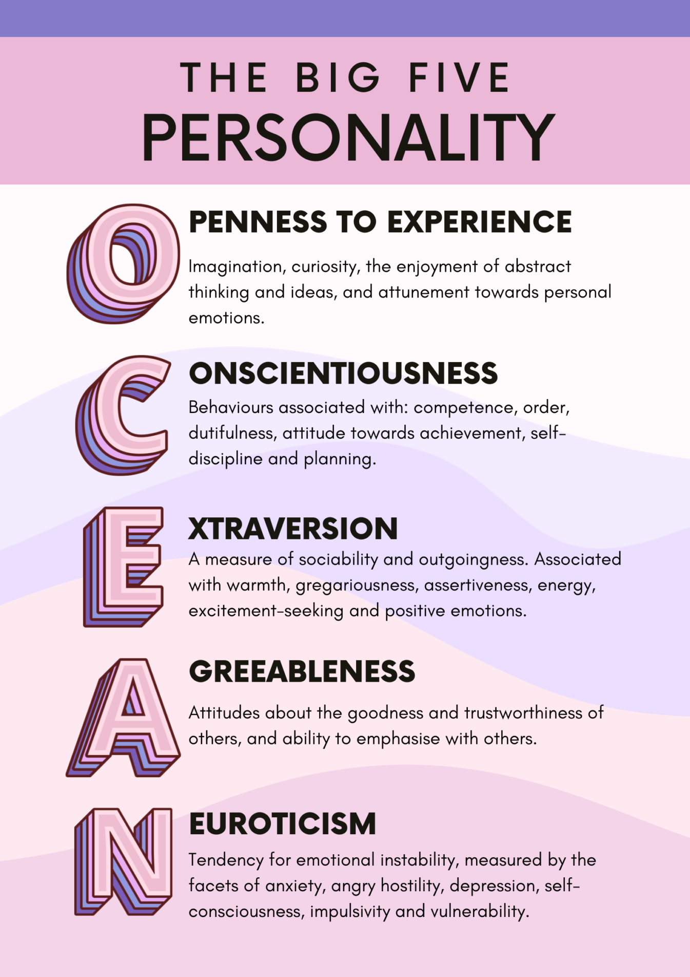
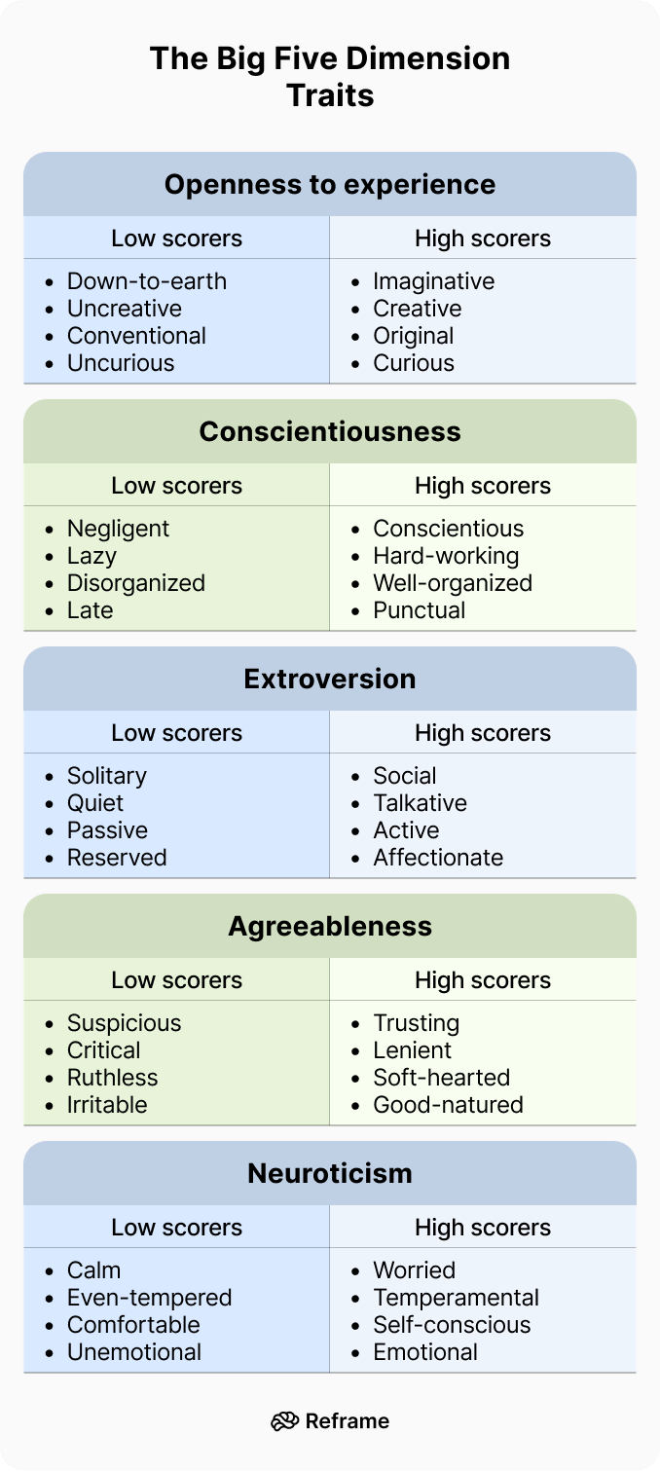

Slide 19
Test your personality
Take the test (60 questions in 5-10 mins):
https://www.truity.com/test/big-five-personality-test
Each type has its unique value!

Slide 20
Predicting personality
Supervised learning (e.g., logistic regression, random forests) can be used to predict Big Five traits from social media activity:
Self-assessment tools: The Big Five is typically measured using standardized questionnaires like the Big Five Inventory.
SM Data collection: APIs to collect posts with user permission.
Accuracy: Studies (e.g., Kosinski et al., 2013) show that models trained on social media data can predict personality traits with correlations of ~0.4-0.6 to self-reported scores.

Slide 21
Feature engineering
Extract useful features of users’ linguistic patterns:
topic diversity for Openness (LDA topics?)
achievement-related words for Conscientiousness
posting frequency for Extraversion
positive sentiment for Agreeableness
emotional stability for Neuroticism (emotional words)
profile metadata (e.g., bio, avatars; selfie? animal?)

Slide 22
Applications of Big Five
User segmentation: Cluster users by personality traits to tailor content or ads. For example, high Openness users may respond to creative, innovative campaigns, while high Conscientiousness users prefer structured, goal-oriented content.
Engagement prediction: Forecast user interactions (e.g., likes) by including features of personality traits. Extraverts are more likely to share content, while conscientious users may engage more often with professional or educational posts.
Example: Build a ML model to predict which users will retweet based on their Extraversion and Openness scores.

Slide 23
Political affiliation
Political affiliation refers to an individual’s self-alignment with a political party, ideology, or movement.
Liberal: Advocates for systemic change, social equality, and policy intervention to promote welfare and rights. On social media, these users often engage with progressive hashtags.
Conservative: Emphasizes tradition, limited government, and preserving established norms. Often prioritizes social stability, economic freedom, and cultural norms.
Independent: Resists the rigid ideological alignment, favoring issue-specific positions over ideological loyalty.
Populist: Focus on representing the ordinary people against those elite class, often emphasizing anti-establishment.

Slide 24
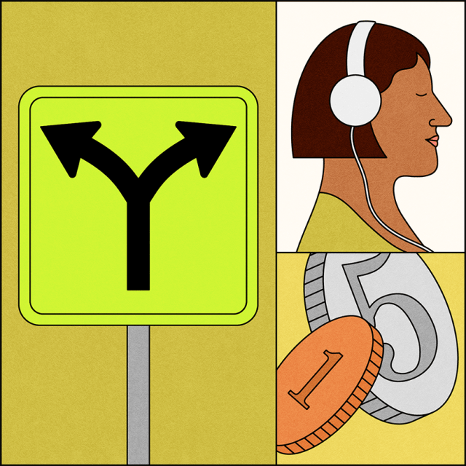
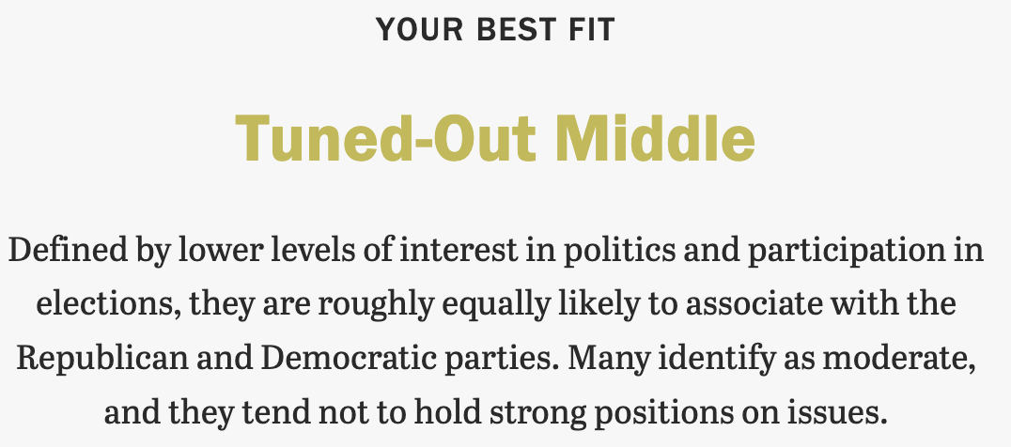
Test your Political Stance
US context:
https://www.pewresearch.org/politics/quiz/political-typology/
Global context:
https://12axes.vercel.app/en

Slide 25
Predicting political affiliation
Useful features for predicting political affiliations:
Linguistic cues: Words, phrases, and sentiment in user posts. Liberals often use inclusive terms (e.g., “equity,” “freedom”); Conservatives favor patriotic language (e.g., “heritage”).
Hashtag and topics: Frequency of interactions with political content. Left-leaning users may engage with social justice hashtags. Topics can signal affiliation (e.g., #BLM for Liberals).
Network features: Following or interacting with accounts of known affiliations (e.g., following progressive politicians for Liberals, authoritative leaders for Conservatives).
Profile Metadate: Bio description & profile image. Terms like “patriot” (Conservative) & “activist” (Liberal) are strong signal.

Slide 26
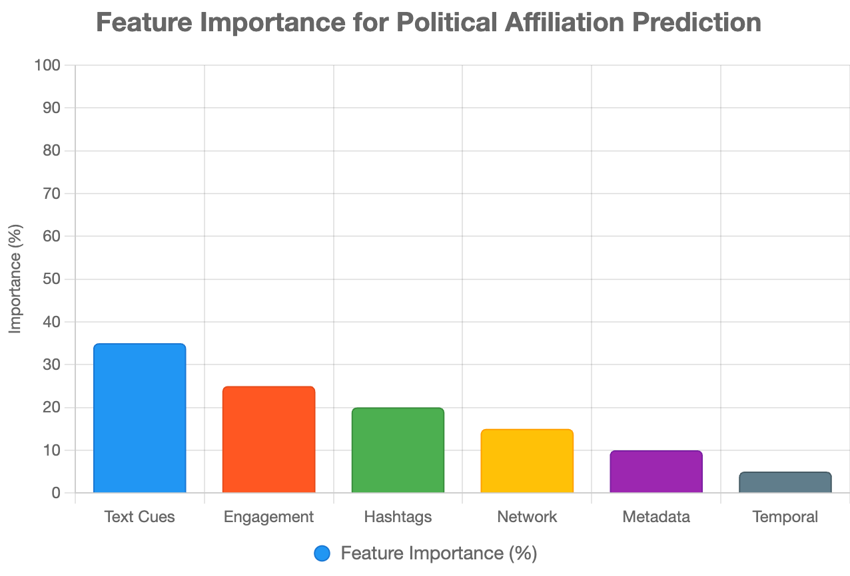
Predicting political affiliation

Slide 27
Health informatics
Research in this area focuses on using social media data to predict physical & mental health issues:
Depression, anxiety, suicide risk, etc.
Empathy, sexual abuse, anonymity
Social support, help seeking on Reddit, etc.
Healthy lifestyle (weight losing, pro-eating disorder)

Slide 28
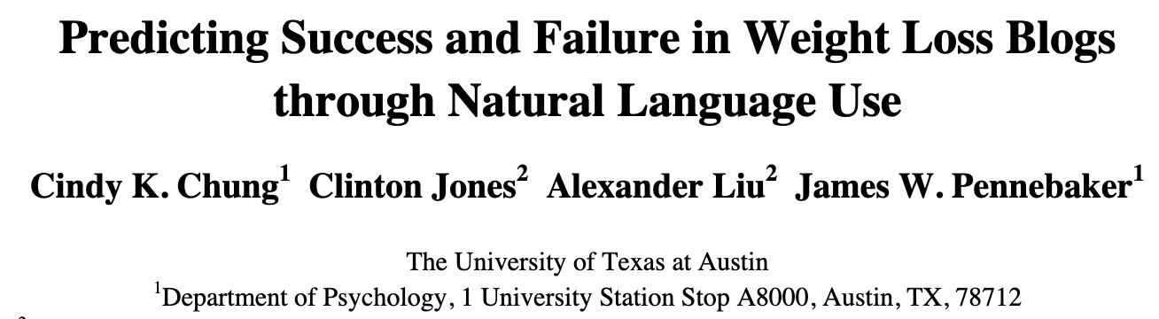

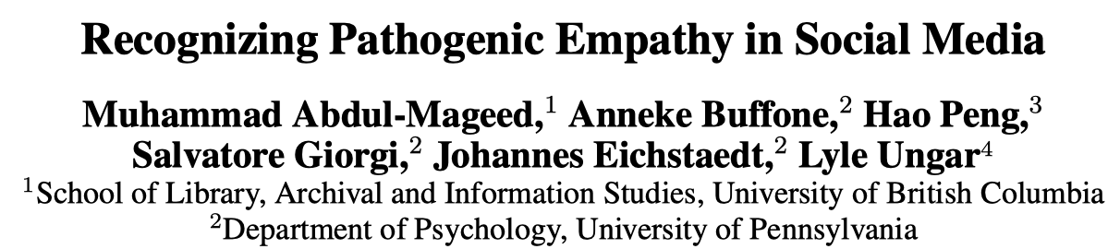
Empathy, depression, weight loss

Slide 29
Modeling mental health outcomes
Leverage machine learning & NLP tools to predict mental health using social media data (e.g., posts, comments, engagement):
Self-assessment tools: use crowdsourcing to recruit a set of social media users who report being diagnosed as depressed; measure their DV based on standard psychometric instrument.
Data collection: Use APIs to collect user data with permission.
Feature engineering: Extract and measure their behavioral attributes such as social engagement, emotion, language use, linguistic styles, ego network, mentions of using medications.
Correlational analysis: Most studies found that social media contains useful signals for predicting onset of mental issues.
Accuracy is not good enough! Can be used as monitoring tools.

Slide 30
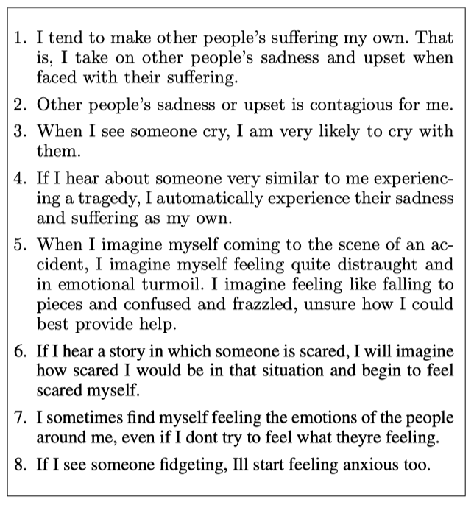
Predicting empathy
Outcome variable: empathy score (continuous, 1-10)
N = 2,405 FB users invited to take a survey questionnaire
Notes:
How does post length affect engagement score?
(Focus on model coeff)

Slide 31
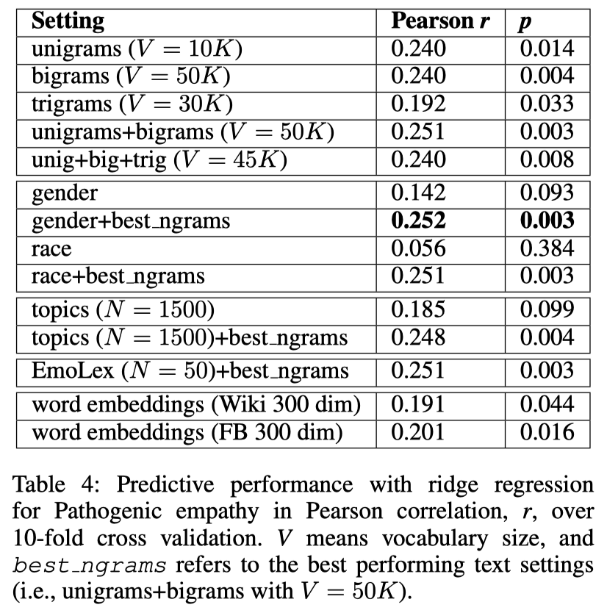
Satisfactory accuracy
Notes:
How does post length affect engagement score?
(Focus on model coeff)

Slide 32
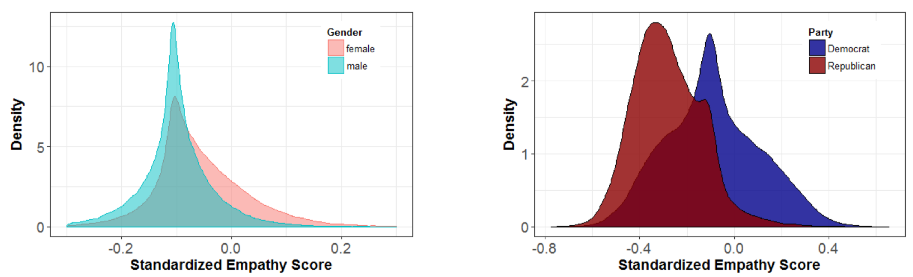
External model validation
Assess model performance on out of sample data:
Empathy score by Gender for 152K FB users (56% female)
Empathy by Political Orientation for 54K Twitter users
Notes:
How does post length affect engagement score?
(Focus on model coeff)

Slide 33
Course notes
Homework 1 due on Oct 16
  Start early
  Individual work
  Consult (not rely on) AI tools
  Skipping human validation will result in 0 score!
  This rule applies to all other assignment / project.
Behavioral Analysis next week

